Slide 1
Human-Computer Interaction
COMS30029
aka #HCI_Theory
Week 2: First Wave
Oussama Metatla and Dan Bennett
Chunk 1: Introduction

Slide 2
Oussama Metatla (and Dan Bennett)
Week 2: First Wave
Chunk 3: Heuristic models, and disagreements
with the first wave
More general approaches in the First Wave, and why HCI started to investigate other approaches
Notes:
Ok, so in the first video we introduced the first wave, in the second we looked at two mathematical models of user cognition: GOMS and Fitts’ law.
But as I said, those approaches were pretty specific. Now we’re going to look at more generally applicable, but less precise approaches from this era.
And then at the end I’m going to talk a little about why some HCI researchers criticised the theory of the first wave, and why later periods of HCI have tended to take a range of other approaches.

Slide 3
GOMS and Fitts’ Law
Grounded in cognitive psychology
Narrow, precise, and predictive
More General, or Heuristic Models
Grounded in cognitive psychology
Broader, generalising, prescriptive
Reading Option 3: Carroll & Campbell: Softening Up Hard Science (1986)
– search google scholar
Notes:
Not all first wave theory was about quantitative, predictive, models.
To be predictive, you need to be quite precise, and it can be hard to be precise about a lot of real world behaviour, which is quite messy.
The Cognitive Psychologists whose work informed these early predictive models had the advantages of conducting their experiments in very carefully controlled conditions, in the lab.
And they tried to understand very small aspects of behaviour in an isolated way.
Lots of these results aren’t very informative in the real world where people are less constrained, where they are free to improvise and switch between different strategies, find creative ways of working, where they are likely to be interrupted by other events.
For example, we may have a great model of how working memory works in an isolated way, but if the user finds a way of performing the task which doesn’t place much demand on working memory, then our model is not going to be much use.
Responding to this, some of the work in the first wave took looser approaches to modelling behaviour. These were still grounded in theories of cognition, and still based on some assumptions about how people do things, and about how cognition works; in these cases, however, they aimed to give broader guidance for designers.
That brings us to the third bit of optional reading for this week: Carrol and Campbell’s Softening Up Hard Science. This paper is really the start of HCI moving away from very precise approaches to modelling and theory, and it’s a good read if you’re interested to find out more about this.
Of the three options this is maybe the least friendly. It’s a classic paper, and rewarding if you can spare the time and effort, but maybe only Masters students, who are interested in cognitive science in HCI might want to pick up this one.

Slide 4
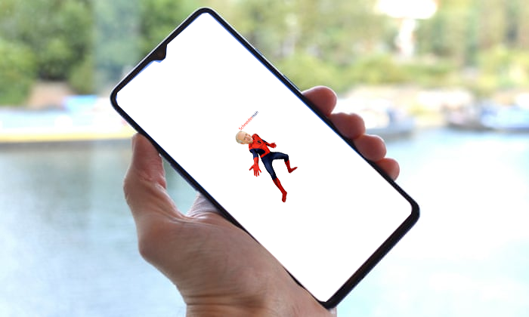

Direct Manipulation: a foundational GUI theory
Notes:
Ok, here’s mobile phone screen showing a photograph. I want to zoom in, to see whose face is on Spiderman’s body how will you I that?
PRESS TO MOVE ON
It’s obvious to everybody in 2021 that I’ll pinch out to zoom.

Slide 5

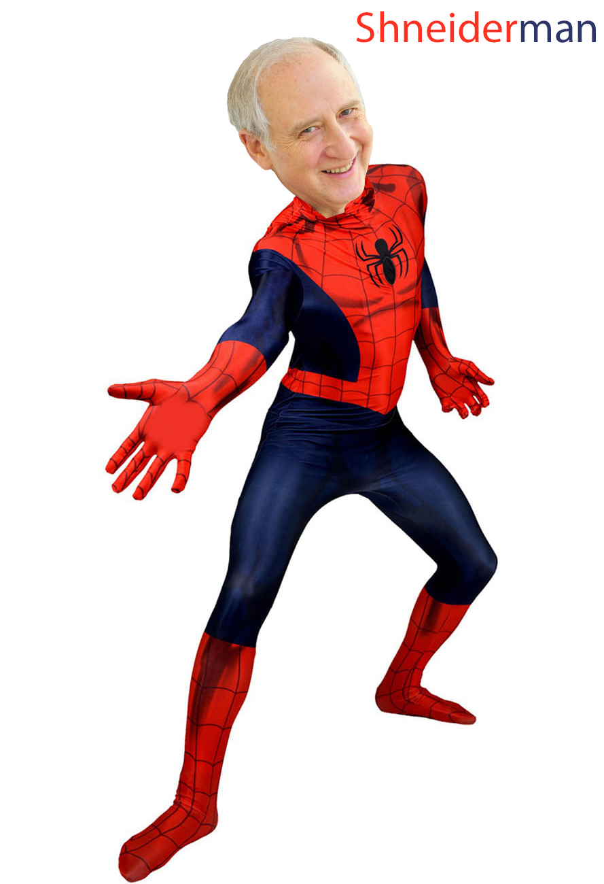
Direct Manipulation: a foundational GUI theory
Notes:
When I do this we’ll see that the face belongs to famous HCI researcher Ben Shneiderman who came up with the idea of Direct Manipulation
And you’ll all realise that this was a First-Wave inspired cognitive trick to help you remember his name.
Ok. So say I now realise this joke is going to land badly, and I’m worried that I might make someone cringe so hard they injure themselves
how will I now throw the image into the recycle bin?
NEXT SLIDE BUTTON
Yep, I’ll click on it NEXT SLIDE BUTTON , and drag it across the screen to the bin. NEXT SLIDE BUTTON
Both of those were examples of direct manipulation.
It’s an idea so successful that it has become invisible. In the very early days of graphical interfaces, Shneiderman proposed that using real-world metaphors for objects and actions would make them more accessible and intuitive. He thought that users could be allowed to control software behaviour by manipulating objects on a screen - dragging the corners of an image to resize it, or moving the object to a visual icon of a bin.

Slide 6
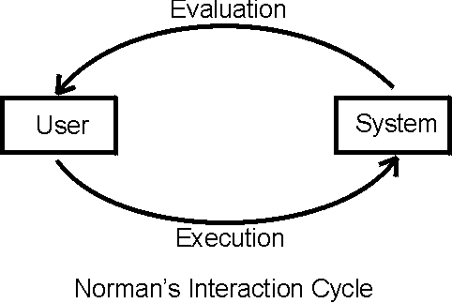
Direct Manipulation: a foundational GUI theory
Notes:
One idea here, developed by other HCI researchers, is that this kind of movement would allow for rapid incremental feedback to the user.
Interaction was seen in terms of cycles in which the user evaluated the situation, and then executed some action to affect the situation in line with their goals (we’ll come back to this again in a moment)
One way of seeing direct manipulation, is in terms of shortening this theorised evaluation, execution loop.
This would be expected to allow the user to correct their behaviour, and evaluate and reformulate behavioural plans on the fly, rather than relying on mental calculations in advance.
Shneiderman expected this to make learning faster and reduce errors.
And I think it’s obvious, whether or not human cognition really does work like that, that the direct manipulation style of design was a success. It’s everywhere.
In contrast to the ideas we saw in the last video, which produced precise mathematical models, we have a more general approach.
Theories from cognitive psychology are packaged into predictions about good design approaches, and general guidelines for design.

Slide 7
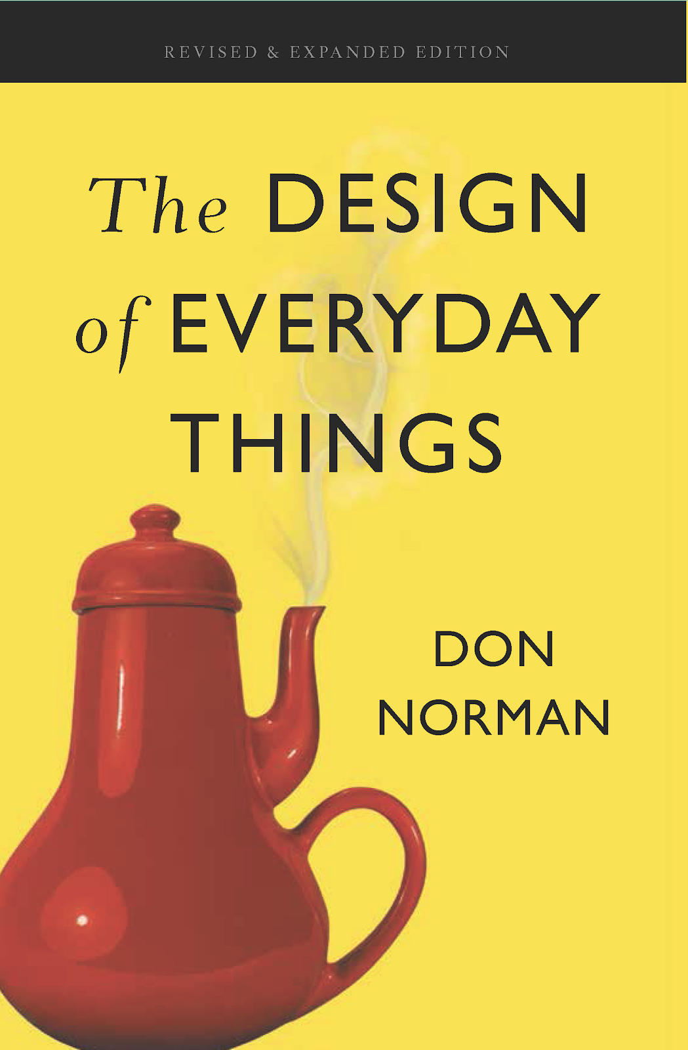
Gulfs of Execution and Evaluation: interaction problems and how to solve them
Notes:
Ok, so staying with this picture of a cycle of evaluations and executions we come to our final theory from the first wave.
This was introduced by one of the most famous of all HCI researchers, Don Norman. It is described in his very popular and highly recommended book The Design of Everyday Things.
There are 2 HCI researchers in my household and two copies of this book.
We start out with an overview of two systems interacting
A human
a computer (or other articfact)

Slide 8
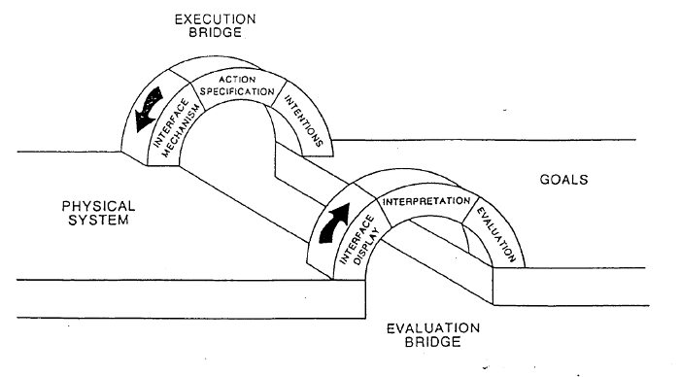
Gulfs of Execution and Evaluation: interaction problems and how to solve them
User
Action plans
System
Capabilities
Notes:
And the situation is imagined as a kind of gulf, or gap between user and system which has to be bridged in two directions, once for execution, and once for evaluation
The user has to evaluate the system’s current state,
And then they have to work out how to move the system from that state, to execute their plan of action.

Slide 9
Gulfs of Execution and Evaluation: interaction problems and how to solve them
User
Action plans
System
Capabilities
Notes:
For evaluation we first need to consider the information displayed by the system, to indicate its current state and possibilities: and the perception of this by the user.
Information about state might be displayed by graphics, text, sound, or any other sensory modality, and the user has to be able to perceive this information well, under current interaction circumstances.
NEXT
We then need to consider the way the user interprets the information they have perceived– various factors might come into play here: the users’ goals, previous interaction context, culture, familiarity with information display norms.
NEXT
Together these lead to an evaluation of the current system state.

Slide 10

Gulfs of Execution and Evaluation: interaction problems and how to solve them
Editing a video: Gulf of Evaluation
Hyper VideoEdit 2097 is only £134 a month!
Evaluated System State
System has a video editor
Actual System State
Vendor wants to sell you a video editor
Notes:
So in 2021 we’re used to operating systems that provide tools for all kinds of things.
Say I just bought a new computer, with an unfamiliar operating system, and I want to edit a video together,
NEXT
I perceive this icon. Then I interpret it - my last machine came with a full featured video editor installed, looks like this one does too.
I click on it and I see this:
NEXT
Great. So this is the gulf of evaluation – the gap between my interpretation of the system state, and the actual system state

Slide 11
Gulfs of Execution and Evaluation: interaction problems and how to solve them
User
Action plans
System
Capabilities
Notes:
When bridging the gulf of execution we move in the other direction, from user to machine.
First the user has an intention
NEXT
Then they specify the action, based on their evaluation of the system
NEXT
Then they carry out the action using the interface mechanism

Slide 12
Gulfs of Execution and Evaluation: interaction problems and how to solve them
Editing a video: Gulf of Execution
Expected Action Plan
Run video editing app
load the video sections
Select each section of video I want, and put it onto a timeline
Required Action Plan
Install and pay for a video editing app
Install a video conversion program
Set the correct parameters for the conversion, looking them up on the internet
Run the video editing app
load the video sections into my app
Select each section of video I want, and put it onto a timeline
Notes:
So when I clicked the icon last time, this was my action plan
NEXT
But as we know,things are harder than this. I have to buy a video editing app.
Then when I install it, I find out the files I have are in an unsupported format.
And I find out that HyperVideoEdit 2097 is terrible. And then I find out that the conversion is difficult for a novice like me – lots of weird parameters to select.
SO I have to do this:
Install a video editing app
Install a video conversion program
Set the correct parameters for the conversion, looking them up on the internet
Load the video editing app
load the video sections into my app
Select each section of video I want, and put it onto a timeline
These first three steps, in orange, exceed my action plan for how to perform the action. They describe the gulf of execution.

Slide 13
Gulfs of Execution and Evaluation: interaction problems and how to solve them
User
Action plans
System
Capabilities
Notes:
I think from those examples you can see that these gulfs are interdependent:
the gulf of execution depend on how much your action plan overlaps with a valid action plan on the system
And your action plan can depend on how well you have understood system state.
Also I think it’s clear that this is the broadest first wave theory we’ve seen so far: it isn’t limited to mouse use, or input, or to GUIs – it is a general model of how users interact with the system.
The idea is that this model can help decompose and diagnose issues with usability: it helps pinpoint wither the issue lies with visibility, interpretation, or maybe with missing system functions

Slide 14
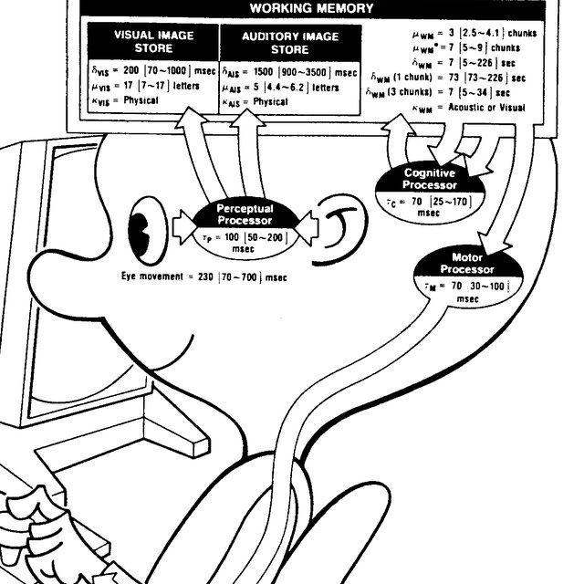
Information processing theories in the First Wave
Gulf of Execution: Wrong method for the task, mismatch in steps (operators)
GOMS
GOALS: what the user wants to do
OPERATORS: individual actions
METHODS: how to combine actions to achieve the goal
SELECTION RULES: how to choose between potential MODELS of the task
Notes:
All the theories we looked at here are grounded in information processing models of cognition, from cognitive psychology – they share some fundamental assumptions and limitations, and as such they are very compatible with one-another.
We saw how direct manipulation was directly related to gulfs of execution and evaluation
And the Gulfs model is also closely related to GOMS.
We can translate the gulf of execution back into the framework of GOMS very easily: a gulf of execution occurs when I don’t have the right Model for the task, and I need to alter it.
That is: I need to form the right intentions, or set of sub-goals, and specify a correct sequence of operations for each to form a method. Using GOMS we could quantify this.

Slide 15
Information processing theories in the First Wave
ALL IN THE BRAIN: all the important stuff is happening via symbol processing in the brain. The body is controlled by the brain without adding too much.
ATEMPORAL: history and order considered minimally relevant, other temporal factors, synchronisation etc. are not considered
ACONTEXTUAL: context is not modelled
COMPOSABLE: Cognitive processes can be broken apart and sections modelled independently without too much loss of accuracy
SIGNAL + NOISE: variability in the process can be treated as noise, distributed in a roughly Gaussian manner
Does any of this matter much to HCI?
Notes:
This is not surprising because both models, share a common view of human behaviour. I’ll describe that theory in outline here, but this description is going to be quite broad brush, and mainly there to give you context for what we do later. Don’t worry about learning this, unless you’re interested. Or ask me during the seminars.
they assumed that behaviour can be well modelled without worrying too much about context and history: they assume performance is consistent across tasks regardless of the order of those tasks, for example, how many times you have repeated the same mouse movement.
Both theories assume human behaviour is organised in a pretty modular way, and that components of behaviour, orders of tasks etc. don’t have a big effect on one another. We can break a task down into sub-processes in the brain, model the processes independently, and and treat the body as effectively being driven by the brain.
Any variability we see will be distributed in a roughly gaussian, random manner. This is how computers work, and it’s a convenient way to model a person’s behaviour.
Now a lot of cognitive science still agrees with many or all of these assumptions. But there are approaches, including in neuroscience, not do not.
One major approach, for example, models cognition using a different mathematical formalism: dynamical systems rather than symbol manipulation processes. This results in a much stronger emphasis on the role of the body and the environment in how cognition and behaviour plays out, and it suggests that many cognitive processes may not be composable as described above, and the presence of persistent time based processes may mean that ordering matters very much.
And researchers in sociology, anthropology have criticised the information-processing view above as reducing cognition to an unrealistically a-social, individualistic thing.
Scientists disagree about things all the time, and in cognitive science competing theories are part of the fabric of the discipline. **Does any of this matter for HCI?** Well, it might or it might not depending on what we are trying to do.

Slide 16
What is the practical effect of these differences in theory? How to choose?
Better fit for phenomenon? Does another theory give a better, more parsimonious account of the interaction we’re observing? Does it explain it better?
Supports Collaboration? helps us understand and be understood by colleagues in another discipline, or another team?
Easy to convert into design? designers can understand and apply the theory to their own practice
Computable, formal? Can we formalise the theory in a model or code, make quantitative predictions, can we use it to build adaptive computer systems?
Other properties? …
Notes:
HCI is in large part a practical, applied discipline.
Theoretical disagreements about basic principles of human behaviour may or may not matter to us, depending on our focus.
Maybe if a theory seems to produce good practical outcomes for our particular case, that might be enough? Maybe.
As we move through the other theories, I want you to think about when and why you might use these theories instead of the first wave (or why you might prefer the first wave for particular cases)
Throughout this course I’d like you to keep thinking about this: If we have two competing theories which could both be used to understand a phenomenon we’re looking at, and in our particular case they both give us similar predictions or recommendations - does it matter which we engage with? Are there reasons why it might matter? Does it matter more in some cases than others? How can we decide?
The most obvious reason might be that one theory better describes a range of other phenomena we are interested in.
But there are other reasons
Another reason might be that we are collaborating with colleagues in another discipline, and one theory might be more consistent with work in that discipline.
One theory might be easier for designers to understand. One theory might be easier to formalise into code and build into a computer system: Fitts’ Law is a great example of that. There are a wide range of reasons in a pragmatic discipline like HCI, which might influence the theories we use and how we use them, quite aside from which theory seems more likely to be scientifically “correct” in every detail.

Slide 17
Where after the First Wave?
Capturing real world behaviour?
Accounts for interaction in real spaces?
Accounts for social and cultural contexts, and constraints?
Accessible to observation?
Notes:
In the case of the theories we have seen this week, many HCI researchers *did* think it mattered. A lot of HCI researchers felt that the broad approach I have presented this week didn’t capture certain features of the way people behave in the world, the way they use information in the world and not only in their heads, and the way things outside the brain became important in interaction: things like bodies and social interactions, and social norms, and eventually things like economic and political systems.
In particular, HCI researchers started to find that the context of use, external resources such as other people, spatial layout of technology, and representations of information in the world outside the screen were integral to how people behaved with technology. People began to feel that the kind of theories we looked at this week didn’t capture interaction as such, they just described an internal model, and that the real conditions of interaction might affect how this internal model worked. They began to develop theories which emphasised more accessible features of human behaviour, that were easier to study, and that allowed them to engage with a wider breadth of human experience. Some of this was influenced by the other theories of psychology, anthropology and sociology which I briefly mentioned above. We’ll hear more about all this in the coming weeks.

Slide 18
Oussama Metatla (and Dan Bennett)
Next week…
Week 3: The Second Wave part 1: From cognition to the experiences of bodies

Slide 19
#HCI
_Theory

